Slide 1
CuPBoP: CUDA for Parallelized and Broad-range Processors
Chihyo(Mark) Ahn
Notes:
Hello everyone, My name is Mark, and It’s my pleasure to have this opportunity to introduce CupBoP , our in-house framework to execute CUDA on non Nvidia devices. And this presentation will be mainly about how we can make cuda source code executable in vortex using this framework.

Slide 2
Agenda
Motivation
Related works
CuPBoP workflow
CuPBoP Runtime Functions
Compilation
Supporting Benchmarks
Notes:
Here, I’m showing the outline of this presentation. I’ll start with the motivation of this work, followed by introducing other works that have similar objectives. And then go over the CuPBoP framework and how we use the framework to execute CUDA source code in Vortex.

Slide 3
Motivation
Notes:
So, let’s begin with the motivation.

Slide 4




CUDA is popular for HPC
Software
Hardware
Notes:
Why did we start this work? There are different programming languages for parallel execution. And for High Performance Computing, CUDA is one of the most popular choice for data-parallel computation compared to other langages, such as OpenCL or SyCL.

Slide 5
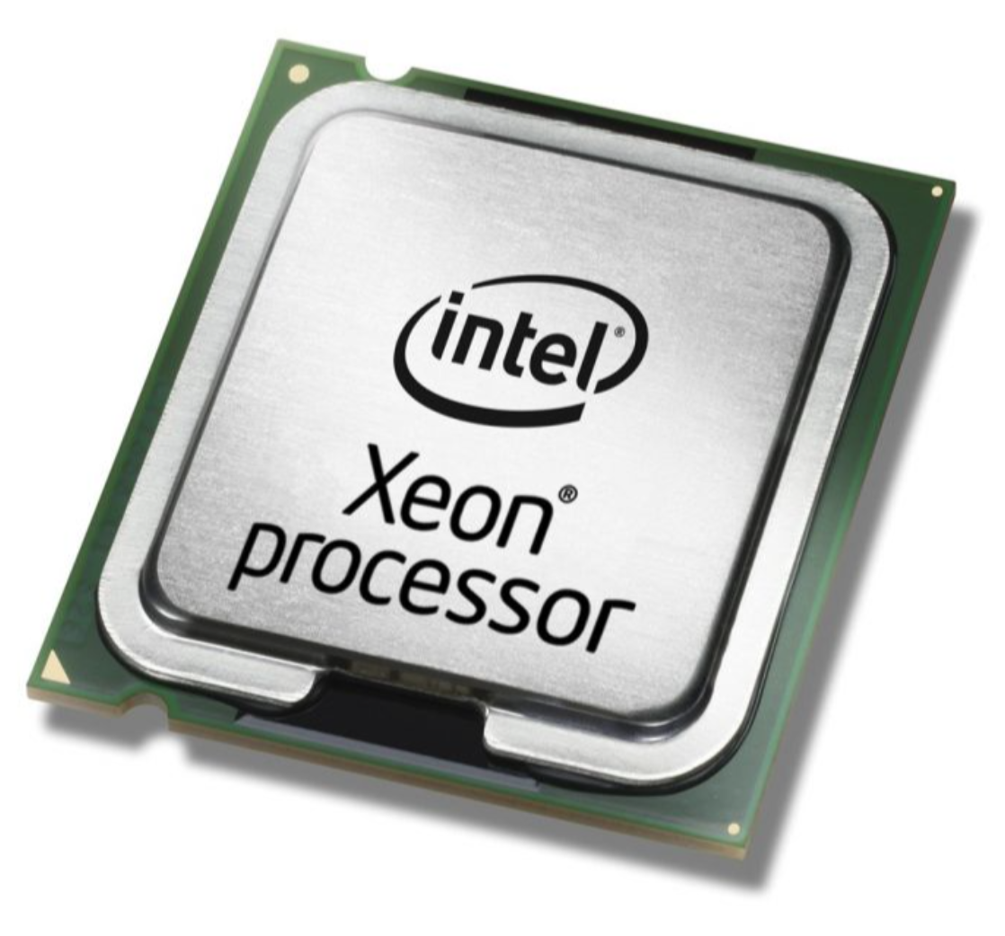
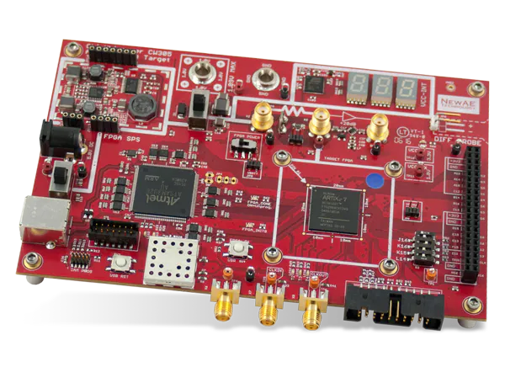
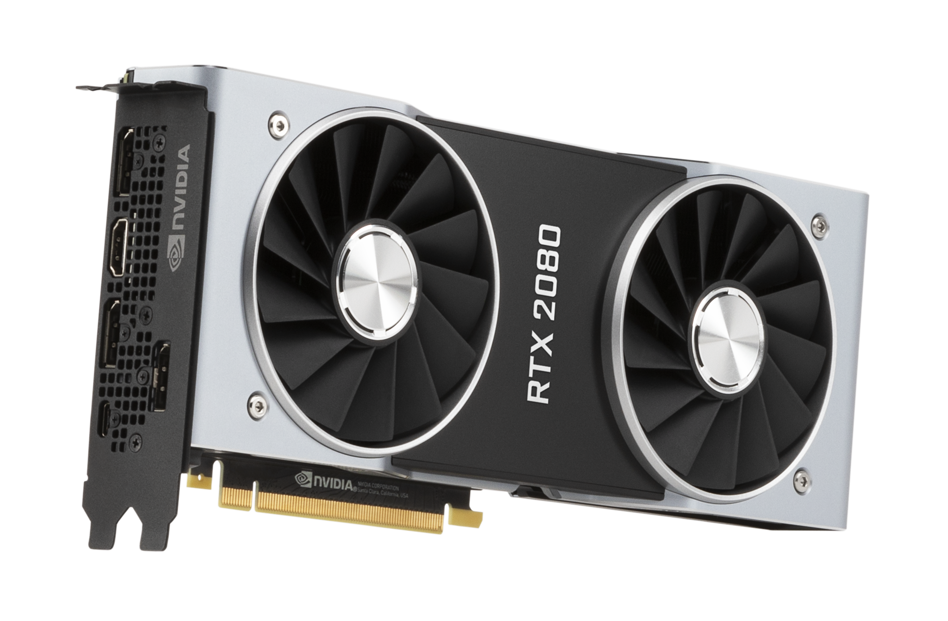
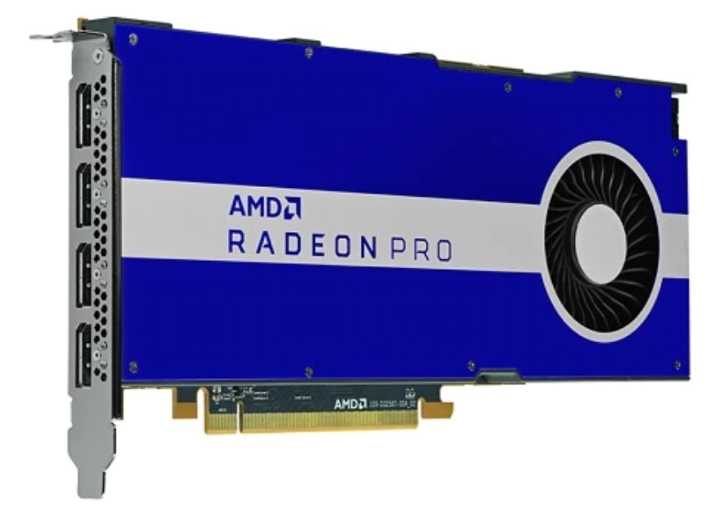
But NVIDIA GPU may be not
Software
Hardware
Notes:
But what about hardware that supports those languages. Natively, Cuda source code can only be executed on Nvidia GPU, and If we're discussing the portion of NVIDIA GPUs in the overall landscape of computing hardware, it is way less prevalent compared to how many cuda source code there are available in this community. In other words, there are simply so many other hardwares that we can utilize if we can run cuda source code on them.

Slide 6
Motivation
Software
Hardware
Notes:
So that was the biggest motivation of our CuPBoP project, which was to make CUDA source code executable in other HW platforms so that users with different HW can make use of more mature cuda community.

Slide 7
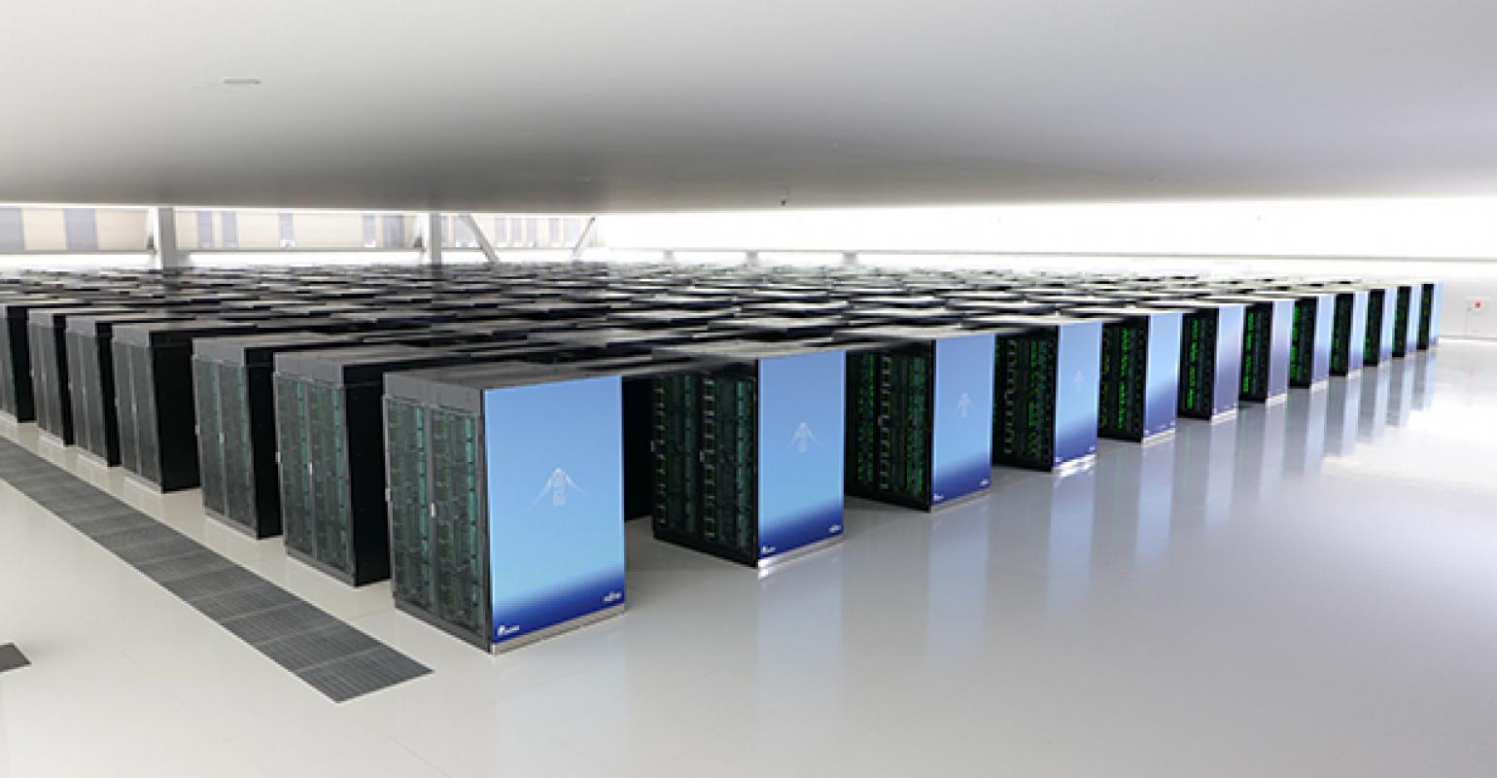

If CUDA can be executed in non-NVIDIA devices...
Other hardware vendors can benefit from the CUDA eco-system;
Allow Single-Kernel-Multiple-Device on heterogeneous system;
No need to migrate CUDA implementations;
…..
Notes:
If Cuda source code can run on multiple HW platforms,
This will benefit Software vendors by making them keep only one CUDA source if they’re targeting multiple HWs
In addition, Hardware vendors who have not previously enjoyed advantages from the CUDA community can now benefit from the CUDA ecosystem.

Slide 8
Related Works
Notes:
Several other projects aim to enable the execution of CUDA source code on non-NVIDIA devices. And These projects including CuPBoP, inevitably share a common process: translating CUDA code to make it compatible with non-NVIDIA hardware. However, methods and level of this translation vary significantly. In the following slides, I will cover at what level each project did the translation to make it executable on non-Nvidia devices, and explain pros and cons for each approach.

Slide 9
CUDA compilation process
CUDA program
host code
LLVM IR
FAT Binary
kernel code
NVVM IR
PTX Assembly
Front-end Compilation
(Clang)
NVPTX
Codegen
Notes:
But first, to provide you with a clearer understanding, I've included a diagram depicting an example of CUDA source code compilation pipeline for NVIDIA GPUs. Within the CUDA source code, we have both host and kernel code. The Clang front-end compiler generates LLVM IR and NVVM IR for the host and device components, respectively. And then, PTX code generation produces PTX assembly code for the device, and the final binary links all of these components together to execute in a heterogeneous system

Slide 10
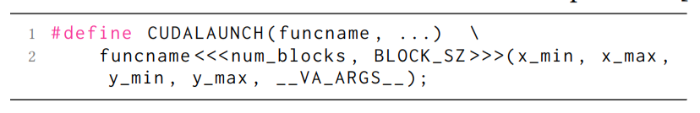
CUDA compilation process
Source to source translation
Pros:
Lightweight, easy to debug and maintain
Cons:
CUDA is based on C++, the grammar is too complicated to be fully covered
Highly depends on the similarity between CUDA and target languages
DPCT, HIPIFY
CUDA program
host code
LLVM IR
FAT Binary
kernel code
NVVM IR
PTX Assembly
Front-end Compilation
(Clang)
NVPTX
Codegen
Notes:
The first approach to make CUDA source code compatible with non-NVIDIA devices involves translating the source code itself. Examples of this approach include DPC++ and HIPIFY. DPC++ translates CUDA code into SYCL, while HIPIFY translates it into HIP, enabling it to run on their respective hardware platforms.
One of the advantages of this approach is that it simplifies debugging, as it deals exclusively with the source code. However, there is a downside: not every CUDA function maps directly to the target language. And therefore, the outcome largely depends on the specific target language the code is translated to. Given that CUDA is grounded in C++ grammar, there is a possibility that these translators may misinterpret the original CUDA code's intent.
DPC++ : Translate Cuda Src code to Sycl
HIPIFY: Translate Cuda Src to HIP

Slide 11
CUDA compilation process
Reverse Engineering
Pros:
No need to re-compile CUDA programs;
Cons:
No official open-sourced PTX parser, hard to maintain and update with latest CUDA.
Ocelot
CUDA program
host code
LLVM IR
FAT Binary
kernel code
NVVM IR
PTX Assembly
Front-end Compilation
(Clang)
NVPTX
Codegen
Notes:
The second approach involves reverse engineering. In this method, PTX assembly code is translated to enable execution on different types of devices. Notably, this approach doesn't impact any of the front-end compilation processes. Users are not required to recompile the CUDA source code to make it compatible with other devices.
However, there's a challenge with this approach. Since there is no official PTX parser provided by Nvidia, these translators need to be continually updated whenever Nvidia makes changes to their compilation pipeline.

Slide 12
CUDA compilation process
Support CUDA migration on LLVM/NVVM IR level
Pros:
No need to handle complicated CUDA grammar.
NVIDIA teams maintain the Clang-CUDA compilation, always up-to-date.
Based on LLVM, which is fully open-sourced.
CuPBoP
CUDA program
host code
LLVM IR
FAT Binary
kernel code
NVVM IR
PTX Assembly
Front-end Compilation
(Clang)
NVPTX
Codegen
Notes:
The final approach is our project, CuPBoP.
CuPBoP stands out from previous approaches by conducting all necessary translations at the Intermediate Representation (IR) level. Similar to reverse-engineering method, one of the significant advantages of this method is that it leverages the Clang front-end compiler, which is maintained by Nvidia, to generate the IR. This eliminates concerns related to complex CUDA grammar. Furthermore, the generated LLVM IR code is fully open-sourced, eliminating the need for any reverse-engineering in the translation process.

Slide 13
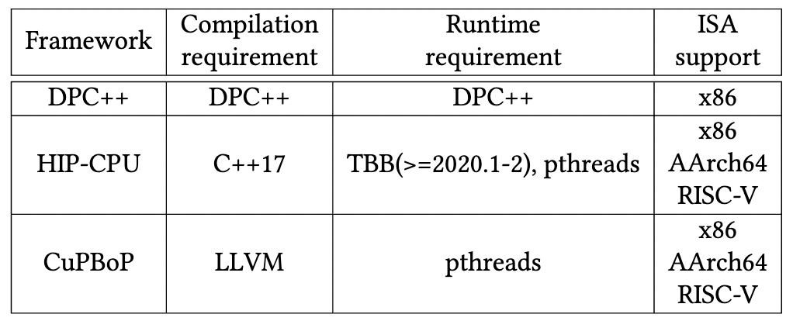
Supported Hardware backend
CuPBoP can execute CUDA on x86, AArch64, and RISC-V backends
Notes:
Here’s a summary of the dependencies and supported ISAs for each framework. Currently, CuPBoP offers support for x86, AMD GPUs, and Vortex.

Slide 14
CuPBoP Framework
Notes:
Building upon our previous discussion of CuPBoP's motivations and high-level overview, it's time to delve deeper into CuPBoP framework.

Slide 15
CuPBoP framework
CUDA program
kernel code
NVVM IR
Translated NVVM IR
Kernel
Executable
Executable file
host code
LLVM IR
Translated
LLVM IR
Host
Executable
Kernel Wrapper
CuPBoP Runtime library
Vortex Kernel
Library
Vortex Runtime
Front-end
Compilation
(Clang)
CuPBoP
Compilation
Transformations
Backend
Compilation
Link
Process
Notes:
Now, let's take a closer look at how CuPBoP operates within the framework. The figure you see illustrates a concise overview of the process. The overarching approach is similar to running OpenCL on Vortex. However, instead of using on PoCL, we leverage the combined power of the Clang front-end compiler and the CuPBoP translator to perform the necessary compilation and translation tasks.

Slide 16
CuPBoP framework
CUDA program
kernel code
NVVM IR
Translated NVVM IR
Kernel
Executable
Executable file
host code
LLVM IR
Translated
LLVM IR
Host
Executable
Kernel Wrapper
CuPBoP Runtime library
Vortex Kernel
Library
Vortex Runtime
1
Front-end
Compilation
(Clang)
Notes:
Let's break down the process step by step. Just as when compiling for NVIDIA GPUs, the Clang front-end compiler generates LLVM Intermediate Representation (IR) and NVVM (NVIDIA Virtual Machine) IR for both the host and kernel source code components.

Slide 17
CuPBoP framework
CUDA program
kernel code
NVVM IR
Translated NVVM IR
Kernel
Executable
Executable file
host code
LLVM IR
Translated
LLVM IR
Host
Executable
Kernel Wrapper
CuPBoP Runtime library
Vortex Kernel Library
vx_spawn_tasks
…
Vortex Runtime
2
CuPBoP
Compilation
Transformations
Notes:
Now, moving on to the second step, CuPBoP's compilation translator comes into play. In this crucial phase, CuPBoP handles all the necessary compilation changes. This includes mapping different types of defined variables and collapsing the CUDA threads, which I'll delve into in a later slide.
Additionally, as part of this process, CuPBoP creates a 'kernel_wrapper.' This wrapper is instrumental in launching the kernel within the Vortex environment, utilizing Vortex kernel library functions

Slide 18
CuPBoP framework
CUDA program
kernel code
NVVM IR
Translated NVVM IR
Kernel
Executable
Executable file
host code
LLVM IR
Translated
LLVM IR
Host
Executable
Kernel Wrapper
CuPBoP Runtime library
Vortex Kernel
Library
Vortex Runtime
3
Backend
Compilation
Notes:
Once all the Intermediate Representations (IRs) and required files are obtained, our backend compiler takes charge. In this step, it assembles the host and kernel executable files, complete with the Vortex-specific Instruction Set Architecture (ISA) (보강 필요)

Slide 19
CuPBoP framework
CUDA program
kernel code
NVVM IR
Translated NVVM IR
Kernel
Executable
Executable file
host code
LLVM IR
Translated
LLVM IR
Host
Executable
Kernel Wrapper
CuPBoP Runtime library
Vortex Kernel
Library
Vortex Runtime
4
Link
Process
Notes:
To bring it all together, we link these two executable files with the CuPBoP runtime library. This linkage is essential for executing the file seamlessly. Furthermore, since our target hardware is Vortex, we also include the Vortex runtime in this phase, ensuring a smooth execution of the file on the intended hardware

Slide 20
CuPBoP framework
CUDA program
kernel code
NVVM IR
Translated NVVM IR
Kernel
Executable
Executable file
host code
LLVM IR
Translated
LLVM IR
Host
Executable
Kernel Wrapper
CuPBoP Runtime library
Vortex Kernel
Library
Vortex Runtime
Front-end
Compilation
(Clang)
CuPBoP
Compilation
Transformations
Backend
Compilation
Link
Process
Notes:
As we traverse through this comprehensive pipeline, CuPBoP takes two pivotal roles. The first role involves IR translation, a fundamental aspect of our process. The second role is to provide runtime library. In the following slides, I will provide a brief overview of each, accompanied by illustrative examples.

Slide 21
CuPBoP framework
CUDA program
kernel code
NVVM IR
Translated NVVM IR
Kernel
Executable
Executable file
host code
LLVM IR
Translated
LLVM IR
Host
Executable
Kernel Wrapper
CuPBoP Runtime library
Vortex Kernel
Library
Vortex Runtime
Implement CUDA APIs for non-NVIDIA devices
Front-end
Compilation
(Clang)
CuPBoP
Compilation
Transformations
Backend
Compilation
Link
Process
Notes:
Let's begin by exploring the CuPBoP runtime library, which is to implement CUDA APIs for non-NVIDIA devices. How does it achieve this?

Slide 22
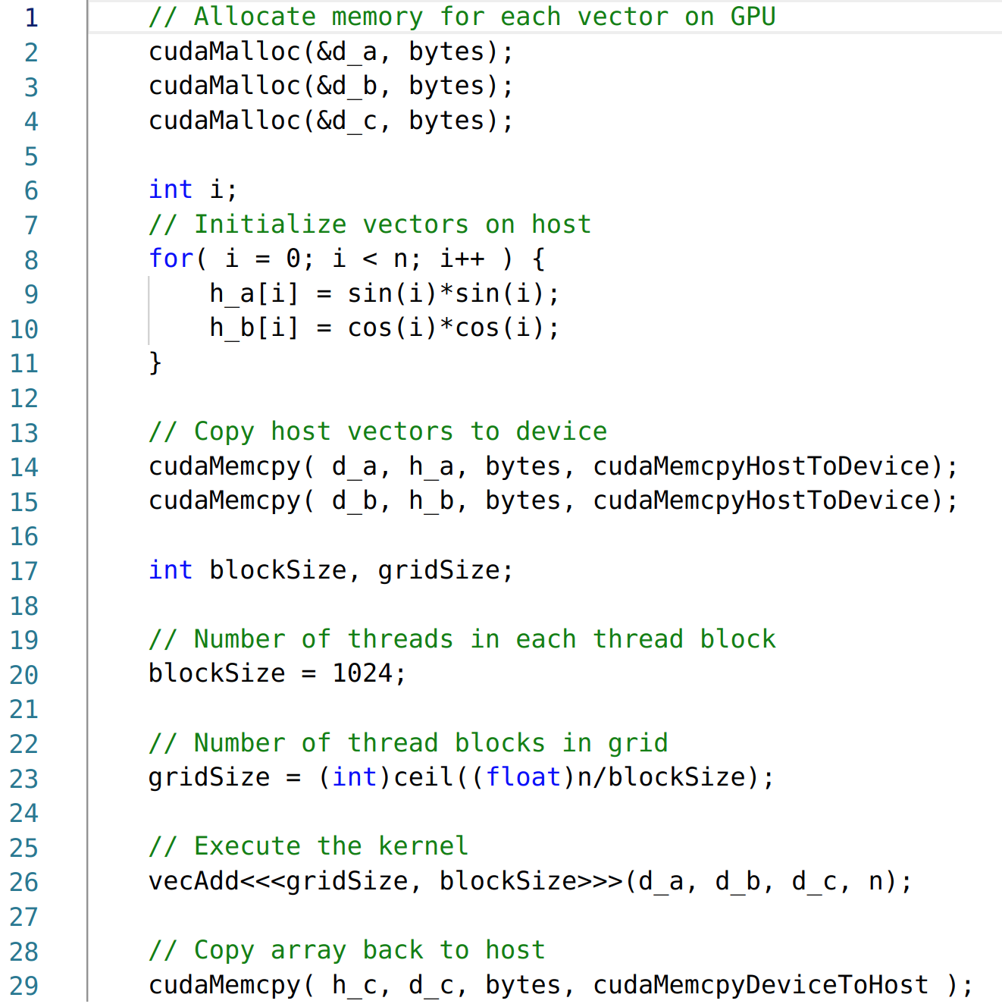
Case study: CUDA Runtime Functions
How should we handle CUDA Runtime functions?
Notes:
Now, let's examine an example of host code in CUDA source code. As you can see, this code contains CUDA-specific functions, such as 'cudamemcpy' and 'cudamalloc.' During execution, these functions are going to be linked to NVIDIA's CUDA runtime functions.

Slide 23
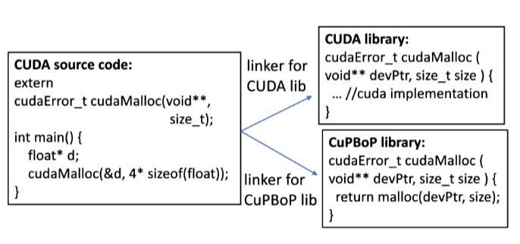
CuPBoP Runtime (CUDA API Implementation)
Vortex Runtime
…
vx_mem_alloc(…)
…
By changing the link path, CUDA code can be executed on Vortex without modifications.
To support a new CUDA API, the developers only need to implement the new API in the library.
Notes:
To make these functions compatible with non-NVIDIA devices, CuPBoP provides a runtime functions with the same function signature as the original runtime functions. For instance, to execute the 'cudamalloc' function on Vortex, we integrate the Vortex runtime library functions that were introduced earlier by Shinnyeong into the 'cudamalloc' function within CuPBoP's runtime library to do a memory allocation in vortex.
And CuPBoP runtime function library will get linked to the binary when it gets. This linkage process enables the binary to run on different hardware configurations without changing the form of the passed functions.

Slide 24
CuPBoP framework
CUDA program
kernel code
NVVM IR
Translated NVVM IR
Kernel
Executable
Executable file
host code
LLVM IR
Translated
LLVM IR
Host
Executable
Kernel Wrapper
CuPBoP Runtime library
Vortex Kernel
Library
Vortex Runtime
Front-end
Compilation
(Clang)
CuPBoP
Compilation
Transformations
Backend
Compilation
Link
Process
Notes:
Now, let's shift our focus to the second major role of CuPBoP, which is during IR translation. Throughout this phase, numerous changes are applied to the original IR code to make it executable on Vortex. But I’ll introduce one of them with an example.

Slide 25
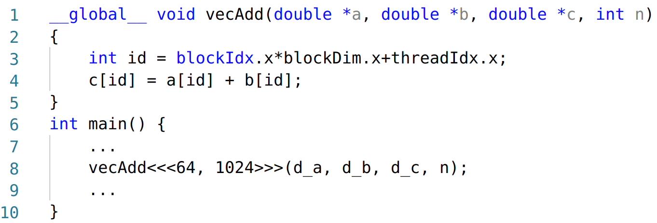
CuPBoP compilation
When the targeted architecture is significantly different from NVIDIA GPU...
There are 64K CUDA threads, much less than the number of active threads in Vortex.
The workload for each thread is too lightweight for each Vortex Thread.
Notes:
NVIDIA GPUs can support executing more than 10000~ of GPU threads. While most CPUs have ~100 cores at most.
Let's consider a simple vector addition CUDA function. With 64 CUDA blocks, each containing 1024 threads, this sums up to 64K CUDA threads that need to be executed. This design aligns well with NVIDIA GPUs, which can efficiently handle thousands of threads simultaneously.
However, the Vortex hardware has fewer active hardware threads available, and executing this workload as is, might prove inefficient for Vortex.
To address this challenge, CuPBoP draws inspiration from what PoCL does for OpenCL-Vortex. It collapses the CUDA threads during compilation translation to ensure more efficient execution on Vortex.

Slide 26
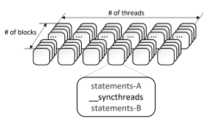
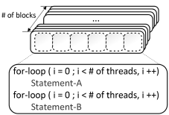
Mapping CUDA Threads to Vortex: PoCL
Step1:
Analyze the Parallel Region[1]
(the regions between barriers that must be executed by all the threads before proceeding to the next region.)
[1] Jääskeläinen, Pekka, et al. "pocl: A performance-portable OpenCL implementation." International Journal of Parallel Programming 43.5 (2015): 752-785.
Notes:
To do that, again, similar to what PoCL did for work-group function, First, CuPBoP analyzes the parallel region of the program where it can execute parallely w/o any synchronization,

Slide 27
Mapping CUDA Threads to Vortex: PoCL
Step1:
Analyze the Parallel Region[1]
(the regions between barriers that must be executed by all the threads before proceeding to the next region.)
Step2:
Wrap each Parallel Region with a single-layer for-loop.
[1] Jääskeläinen, Pekka, et al. "pocl: A performance-portable OpenCL implementation." International Journal of Parallel Programming 43.5 (2015): 752-785.
Notes:
Next, it wraps each parallel region with a single-layer for-loop. This way, each loop is dedicated to carrying out the same computation that was initially allocated for a CUDA block.

Slide 28
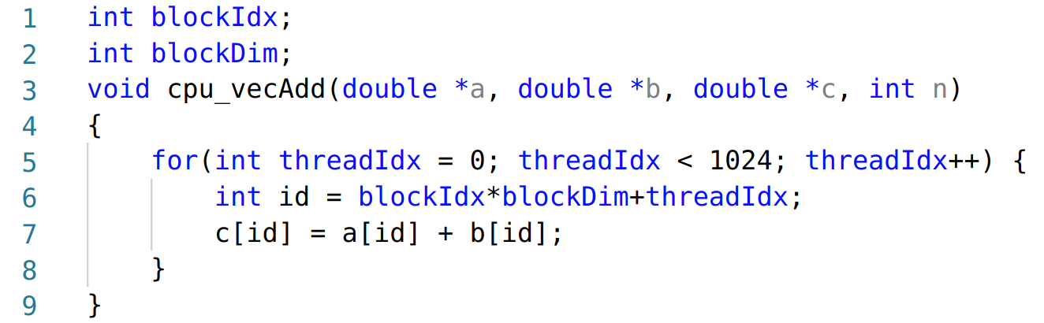
CuPBoP compilation
64K threads are required
The workload for each thread is too lightweight for each Vortex Thread for efficient execution
Compilation Transformations
Only 64 threads are required
The workloads are much heavier, which is more friendly to Vortex HW.
Notes:
So here I’m showing the example before-and-after comparison after this pass. While all these changes occur at the IR level, we present in source code to facilitate a clearer understanding. As you can observe, the transformation reduces the initial 64,000 threads to a mere 64 threads. This streamlined approach can be significantly more efficiently mapped to Vortex hardware threads.

Slide 29
Mapping CUDA Kernel to Vortex
CUDA processing model
Thread
Block
Kernel execution instance
Vortex Warps
Thread
Warp
Core
Thread
Vortex
Core
Core
Warp
Warp
Block
Thread
Thread
…
Kernel Instance
Notes:
Through this example, you can see how CuPBoP's IR translation process effectively maps each CUDA block to an individual Vortex hardware thread. However, it's important to note that this is just one facet of the comprehensive IR translation carried out by CuPBoP.
In addition to this, CuPBoP undertakes various other passes, such as handling CUDA shared and constant memory, and modifying kernel arguments for launching kernels. All these combined efforts are geared toward making CUDA code fully executable and optimized for Vortex.

Slide 30
Evaluation (Rodinia)
Benchmark Name | feature | Support (64bit)
Gauss | Multi-kernel in series | O
BFS | - | O
NN | Math Library (sqrt) | O
NW | Shared Mem. | O
Srad_v2 | Shared Mem. + Syncthreads | O
Hotspot | Shared Mem. + Syncthreads | O
StreamCluster | Constant Mem. | O
Myocyte | - | O
Pathfinder | Shared Mem. + Syncthreads | O
LUD | Shared Mem. + Syncthreads | O
Btree | - | O
Backprop | __powf, __log2f | O
CFD | CudamemcpytoSymbol + Constant Memory | △
Huffman | Atomics | X
Notes:
To validate the availability and effectiveness of our translator, we conducted tests by attempting to execute CUDA examples from the Rodinia benchmark on the Vortex platform. The results are promising. Our pipeline currently supports the majority of examples, specifically 13 out of 17 within the benchmark suite. For those few remaining unsupported examples, rest assured that our dedicated team continues to work to expand our compatibility and provide even more comprehensive support.

Slide 31
Q&A
Thanks for your time!
CuPBoP(x86) is an open-source project on Github.
We welcome any kinds of contribution & feedback.
CuPBoP link: https://github.com/cupbop/CuPBoP
Related papers:
CuPBoP: CUDA for Parallelized and Broad-range Processors
Notes:
That was the end of my brief introduction of CuPBoP, Thank you for your attention. At present, the CuPBoP framework for the x86 platform is available as an open-source project. We encourage you to explore it, and we welcome any feedback you may have. If you have any questions, please don't hesitate to reach out.

Slide 32
Mapping CUDA Kernel to Vortex: Core Mapping
CUDA processing model
Thread
Block
Kernel execution instance
Vortex Warps
Thread
Warp
Core
Thread
Vortex
Core
Core
Warp
Warp
Block
Thread
Thread
…
Kernel Instance
Can Make Better Use of HW Resources

Slide 33
PoCL: Work-group Function Generation
Generate code for executing all threads in a cuda block (from HW thread’s view)
Analyze Parallel Region
Flat Collapsing
Insert Loop for executing all threads in a block
entry
entry
kernel foo(){
doWorkA()
barrier()
doWorkB()
}
Work A
Work A
#threads
barrier
barrier
Analyze Parallel Region
Flat Collapsing
Work B
Work B
#threads
exit
exit
Notes:
Originally pocl compiler generate work-group function.
PoCL analyze parallel region of the program which can execute parallelly without any sinchronize.
Then insert loop for executing all work-item in a work group, which are called flat collapsing.
Based on the flat collapsing, PoCL can generate code for the CPU.
When we have a kernel function such as left figure.
They find two prallel reiong for work A nad workB by analyze parallel region.
Then perform flat collapsing to generate workgroup function, with generating loop for iterate workA, removing barrier, and generting loop for workB.
Now, work-group function can execute all the work-items.

Slide 34
Mapping 0: Thread Mapping
PoCL work-group function
Execute All work-items in a work-group
Thread Mapping
Mapping one block to one HW thread
Distribute work-group among all HW threads
All threads: wavefronts * thread
for (all threads) {
}
Warp 0~N
pocl::wg_func()
for (remaining threads) {
}
Warp (0)
pocl::wg_func()
Notes:
With this work-group function, we can simply execute program on the vortex, called thread mapping.
Every thread execute workgroup function, which means mapping one work-group to one hw thread.
The workgroup is distribute among all threads.
Using the given mapping, it is possible that the number of work-groups is not a multiple of the number of threads in a wavefront.
To execute the remaining work-groups, we make the program flow as shown in the right figure, add additional wavefront for dealing remaining work-group.

Slide 35
Mapping 1: Core Mapping
PoCL work-group function
Execute some threads in a block
Iteration id initialized with hw thread id
Stride is all HW thread
Call HW barrier
Core Mapping
Mapping one block to one HW Core
Distribute work-item among all threads
All threads: wavefronts * thread
entry
entry
Work A
Work A
#threads
/ All HW thread per core
barrier
HW barrier
Flat Collapsing for Core Mapping
Work B
Work B
#threads
/ All HW thread per core
exit
exit
for (all threads) {
}
Warp 0~N
pocl::wg_func_cm()
Notes:
Instead of mapping work-group to vortex thread. We can mapping one work-item to one vortex thread, which called core mapping.
To generate code for the core mapping, we need to generate work-group function with changed loops.
Each parallel region need to be iterate Dividing work items by the number of threads. And the global_id and local_id need to be initialized by using hardware thread id and hardware wavefront id.
Also we need to insert hardware barrier.
Base on the core mapping we can distribute work-item among all threads. And can remove additional wavepoint to deal with remain work group.

Slide 36
How to use CuPBoP (x86)
Step 0: Build CuPBoP
Requirement:
Linux system (recommended: Ubuntu 20.01)
LLVM 14.0.1
CUDA toolkit (CuPBoP needs CUDA toolkit to compile the source programs to NVVM/LLVM IRs.)
CMake

Slide 37
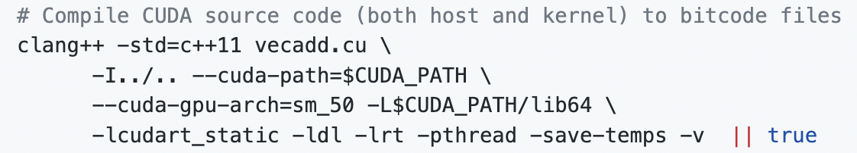
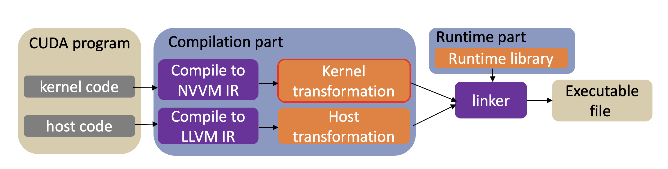
How to use CuPBoP
Step 1: Compile CUDA programs to NVVM/LLVM IRs
This will generate two IR Files:
vecadd-cuda-nvptx64-nvidia-cuda-sm_50.bc for NVVM IR (kernel)
vecadd-host-x86_64-unknown-linux-gnu.bc for LLVM IR (host)

Slide 38
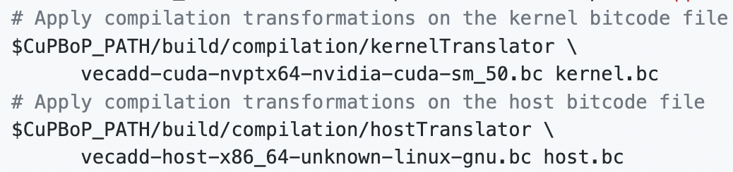
How to use CuPBoP
Step 2: Apply transformations on both IRs.(CuPBoP compilation part)
The transformed kernel/host IRs are stored in kernel.bc/host.bc

Slide 39
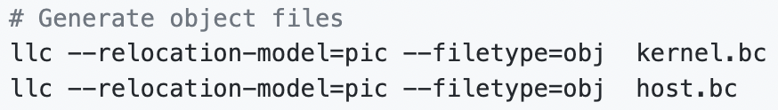
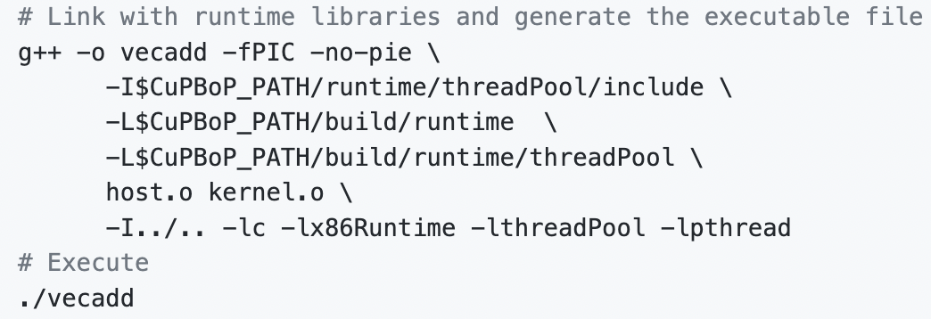
How to use CuPBoP
Step 3: Generate object files.
Step 4: Link object files with runtime libraries (CuPBoP runtime part) to generate the executable file.

Slide 40
Experiments: benchmark coverage
 | DPC++ | HIP-CPU | CuPBoP
Rodinia-GPU | 56.5 | 56.5 | 73.9
Crystal | 0 | 76.9 | 100
CuPBoP achieves the highest coverage.

Slide 41
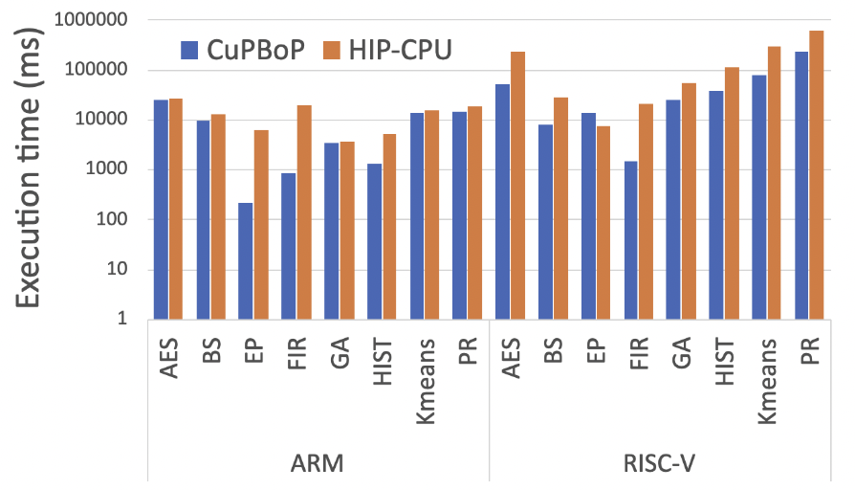
Experiments: performance
CuPBoP is 7.83x/4.25x times faster than HIP-CPU on AArch64/RISC-V.
CuPBoP is 2.28x faster than DPC++ and 3.36x faster than HIP-CPU on x86.

Slide 42
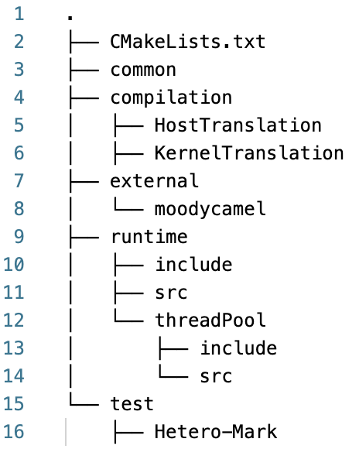
CuPBoP code structure

Slide 43
CuPBoP code structure
Third party projects:
Moodycamel: A C++ lock-free queue implementation. It is used in CuPBoP runtime part;
Hetero-Mark: a HPC benchmarks, used for verification the correctness.

Slide 44
CuPBoP code structure
The utility that will be used by both compilation part and runtime part.
For example, DEBUG_INFO

Slide 45
CuPBoP code structure
CuPBoP compilation part. Most code is about LLVM transformations.

Slide 46
CuPBoP code structure
A part of CuPBoP runtime library. It focuses on the implementation for submitting/scheduling tasks (CUDA kernel launch) from host to devices.

Slide 47
CuPBoP code structure
A part of CuPBoP runtime library. It implements two kinds of CUDA APIs:
Runtime function: the functions be executed on the host (e.g., cudaMalloc)
Kernel function: the functions be executed on the device (e.g., nv_powf)

Slide 48
Future works
Optimize CuPBoP performance
Support CUDA libraries (e.g., cuBLAS, cuDNN...);
Can we execute CUDA programs on other devices faster than NVIDIA-GPUs?

